Slide 1
Malignant Comments Classifier Project

Slide 2
Problem Statement (Classification Problem)
The proliferation of social media enables people to express their opinions widely online. However, at the same time, this has resulted in the emergence of conflict and hate, making online environments uninviting for users. Although researchers have found that hate is a problem across multiple platforms, there is a lack of models for online hate detection.
Online hate, described as abusive language, aggression, cyberbullying, hatefulness and many others has been identified as a major threat on online social media platforms. Social media platforms are the most prominent grounds for such toxic behaviour.
There has been a remarkable increase in the cases of cyberbullying and trolls on various social media platforms. Many celebrities and influences are facing backlashes from people and have to come across hateful and offensive comments. This can take a toll on anyone and affect them mentally leading to depression, mental illness, self-hatred and suicidal thoughts.
Internet comments are bastions of hatred and vitriol. While online anonymity has provided a new outlet for aggression and hate speech, machine learning can be used to fight it. The problem we sought to solve was the tagging of internet comments that are aggressive towards other users. This means that insults to third parties such as celebrities will be tagged as unoffensive, but “u are an idiot” is clearly offensive.
Our goal is to build a prototype of online hate and abuse comment classifier which can used to classify hate and offensive comments so that it can be controlled and restricted from spreading hatred and cyberbullying.

Slide 3
Understanding The Data
The data set contains the training set, which has approximately 1,59,000 samples and the test set which contains nearly 1,53,000 samples. All the data samples contain 8 fields which includes ‘Id’, ‘Comments’, ‘Malignant’, ‘Highly malignant’, ‘Rude’, ‘Threat’, ‘Abuse’ and ‘Loathe’.
The label can be either 0 or 1, where 0 denotes a NO while 1 denotes a YES. There are various comments which have multiple labels. The first attribute is a unique ID associated with each comment.
The data set includes:
Malignant: It is the Label column, which includes values 0 and 1, denoting if the comment is malignant or not.
Highly Malignant: It denotes comments that are highly malignant and hurtful.
Rude: It denotes comments that are very rude and offensive.
Threat: It contains indication of the comments that are giving any threat to someone.
Abuse: It is for comments that are abusive in nature.
Loathe: It describes the comments which are hateful and loathing in nature.
ID: It includes unique Ids associated with each comment text given.
Comment text: This column contains the comments extracted from various social media platforms.

Slide 4
Motivation For The Problem Undertaken
Our goal is to build a prototype of online hate and abuse comment classifier which can used to classify hate and offensive comments so that it can be controlled and restricted from spreading hatred and cyberbullying.

Slide 5
EDA Steps And Visualizations
Head View
Sample View
Tail View
Exponential View
Descriptive Stats
Scatter Plots
Correlation Analysis
Distribution Plots

Slide 6
Dashboards

Slide 7
Dataset Visualization
Follow the link to the dashboard:
https://docs.google.com/presentation/d/1DiZbjrNyupIfSy6BD9Z7Ly-y8jXmza6FDFjgFj9oAxA/edit?usp=sharing

Slide 8
Exponential View Of Dataset
Follow the link to the dashboard:
https://docs.google.com/presentation/d/1-d5t6NuMkbTgQdJj4bz1rRniwxxx7SD5IPIMaCPrJ5o/edit?usp=sharing

Slide 9
Scatter Plots
Follow the link to the dashboard:
https://docs.google.com/presentation/d/1AwzVWdihXRvpq8FR3Oh7Cd9Vf4jH9gAbnoVVDEn7dno/edit?usp=sharing

Slide 10
Histograms
Follow the link to the dashboard:
https://docs.google.com/presentation/d/1Hki6b-LDcIpBa6mlN_MCfnND2UN6XhuqfXndnzioPUg/edit?usp=sharing

Slide 11
Correlation Analysis
Follow the link to the dashboard:
https://docs.google.com/presentation/d/1Jnrkgl-flf61_neoaTYJ5B4UYfND5SYja9pkPgUNawM/edit?usp=sharing

Slide 12
Descriptive Analysis
Follow the link to the dashboard:
https://docs.google.com/presentation/d/1cWBYgixIs2f2Wffow9UjOM-itoE2wpMur3iSaGvT6Sc/edit?usp=sharing

Slide 13
Distribution Plots Analysis
Follow the link to the dashboard:
https://docs.google.com/presentation/d/1t38B5URUYV9QCBYBTQlDj_FdPE9a6L8iFVrmftPAM_Q/edit?usp=sharing

Slide 14
Conclusion Of EDA
Based On EDA done above in two parts, it can be concluded that all the features are relevant for making prediction because of moderate to strong correlation with the label. Even the outliers don't seem to be very high. However, the pattern in all the columns is that skewness and kurtosis are not normal. To overcome this problem and to arrive at good prediction, I will following steps:
Feature Scaling
Outliers Transformation.
ANOVA Test.
Resampling

Slide 15
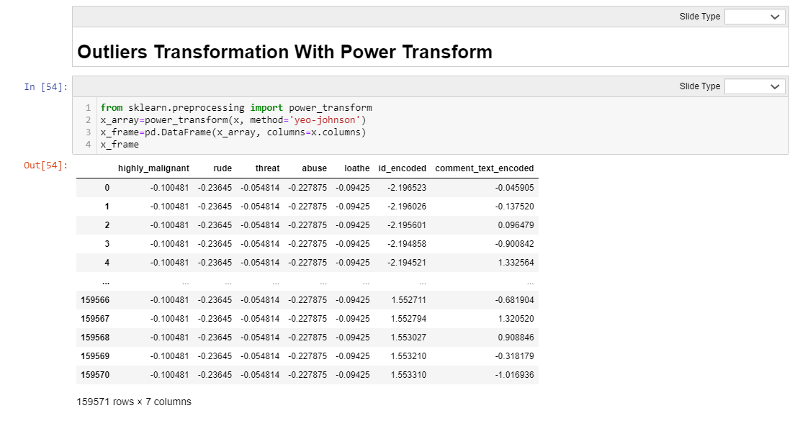
Outliers Transformation

Slide 16
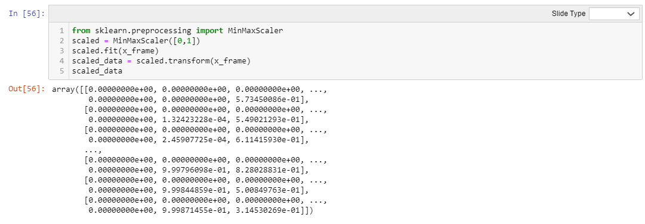
Min Max Scaling

Slide 17
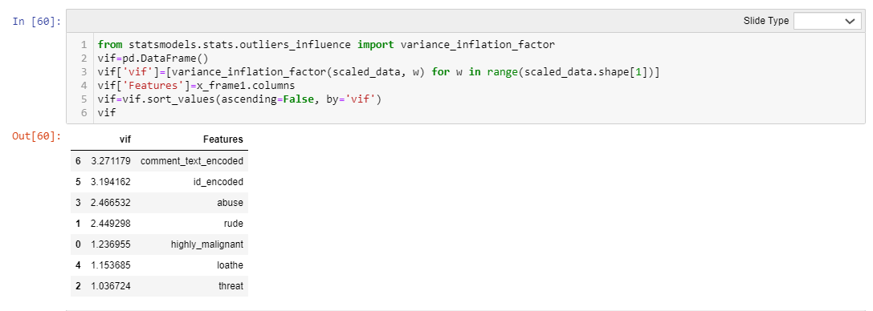
VIF Test

Slide 18
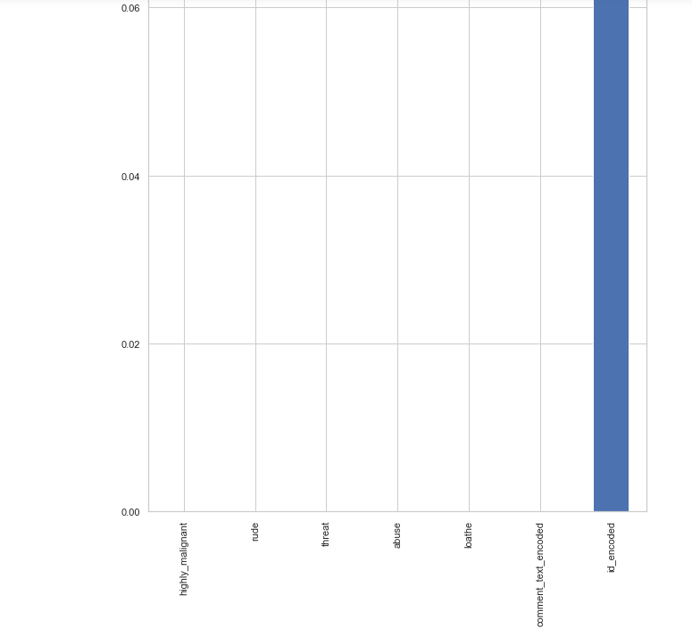
ANOVA Test

Slide 19


Slide 20
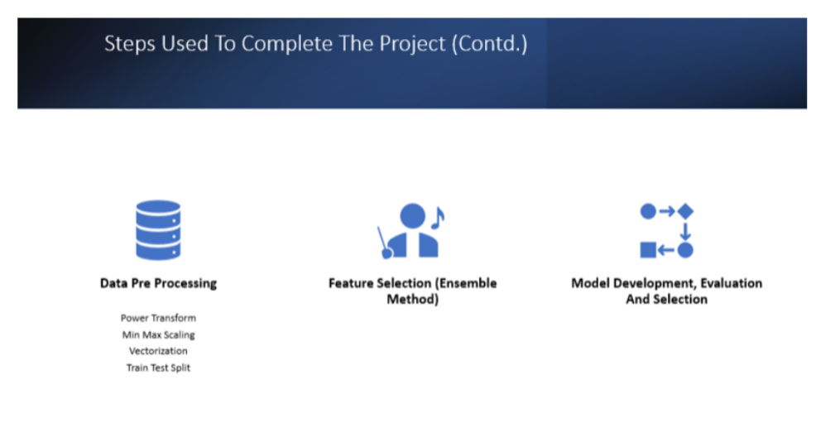
Resampling

Slide 21
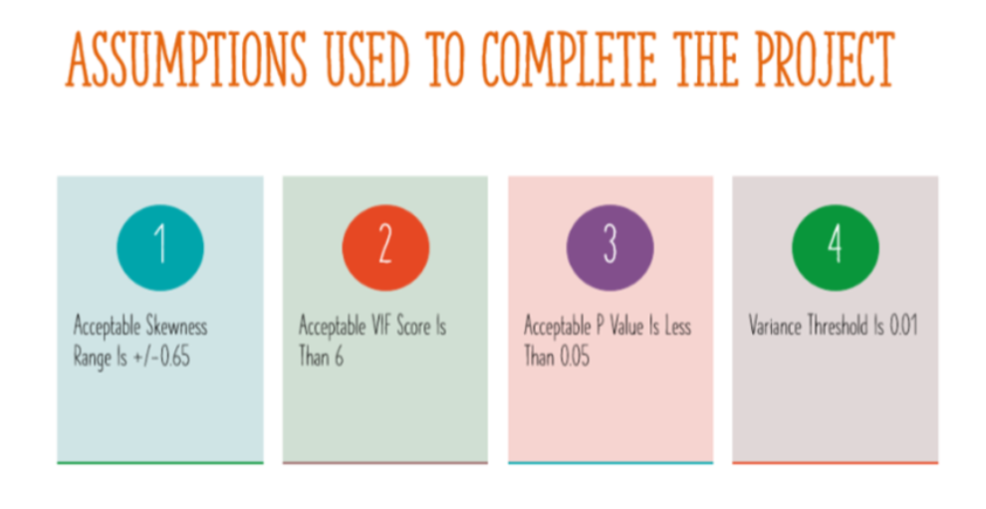

Slide 22
Models Dashboard
Follow the link to the dashboard:
https://docs.google.com/presentation/d/1EM_uwcOdGyUzsvdwFH0xh4MR0SW-_yaV2Gl3aumG2Kw/edit?usp=sharing

Slide 23
Conclusion
Visualizations and data cleaning convert a whole complex and messy dataset into insightful and interesting representation, which make it easier to reach the core of the problem and solve it. ·· The best model is RFC With Default Hyper Parameter tuning on resampled data, the most challenging part in models development process was to reduce overfitting and biases in the data, that is why I have applied ensemble methods on base estimators... RFC provided the best framework to reduce overfitting. By running it on resampled data, I achieved an accuracy score of 1.0.

Slide 24
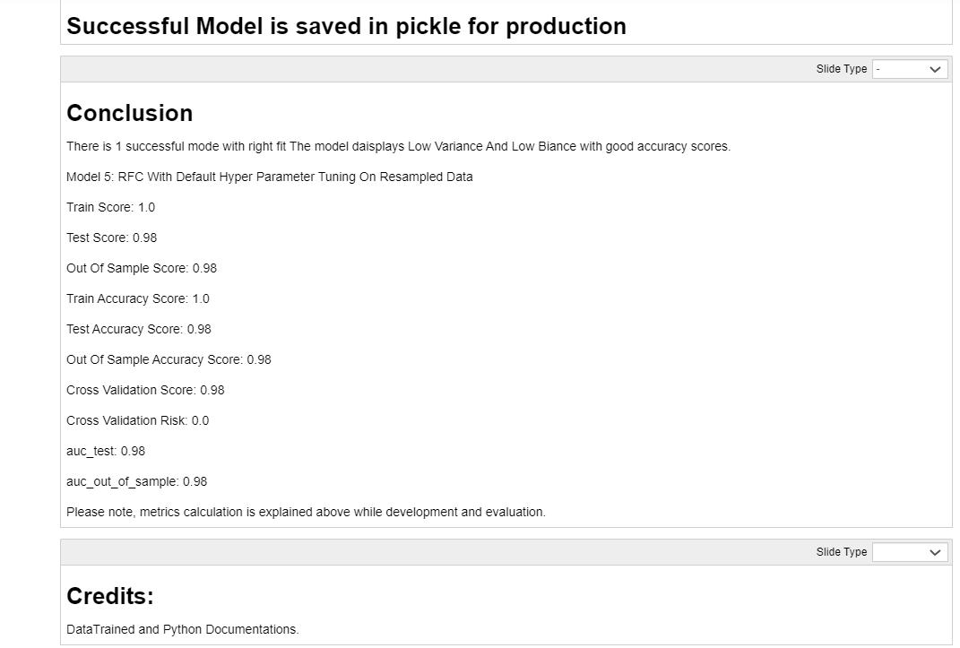

Slide 25
Thank You

